Slide 1
WEEK 6
Forecasting in Pharma:
the Patient Funnel
A simple model, well-documented assumptions, and an honest range.
Andi Cupallari · Applied Data Science and AI in Pharma Commercial · Fall 2026 · Monday, October 19
Week 6 — Forecasting in Pharma: the Patient Funnel · Pharma DS&AI · Fall 2026
1 / 40
Notes:
Case: LYMBREXA, a fictional third-in-class bispecific in DLBCL; GLUCOREN for the prevalence model and LOE. All data synthetic. The model lives in Week_06_LYMBREXA_Forecast_Model.xlsx and in the notebook — same numbers. Homework 2 released tonight (due Mon Nov 2, 11:59 PM ET).

Slide 2
AGENDA
Tonight
0
What a forecast is for
Budget vs long-range plan; who uses each
1
Patient models
Incidence vs prevalence; flow vs stock
2
The assumption book
A forecast is a list of assumptions
3
From data to assumptions
Progression, persistence, uptake, share
4
The forecast
Funnel → brand → budget and long-range plan
5
Ranges
Scenarios, tornado, the plan of record
6
Checks
Market trend, regional split, LOE, prevalence model
7
Close
Governance · exercise · Homework 2
Week 6 — Forecasting in Pharma: the Patient Funnel · Pharma DS&AI · Fall 2026
2 / 40

Slide 3
00
What a forecast is for
Two horizons, one model, many readers.
Week 6 — Forecasting in Pharma: the Patient Funnel · Pharma DS&AI · Fall 2026
3 / 40

Slide 4
0 · TWO ASKS
Two questions, one model
LYMBREXA: fictional 3rd-in-class bispecific · 3L+ DLBCL Jan 2027 · 2L label mid-2028
Brand lead — budget
“Monthly patients and revenue for 2027–28. Supply needs vials by month.”
Portfolio strategy — long-range plan
“Annual revenue to 2041. The plan says $250M in 2029, $400M at peak.”
One patient funnel
driven by one assumption book
A launch has no sales history. Its forecast is built from patients and assumptions.
Week 6 — Forecasting in Pharma: the Patient Funnel · Pharma DS&AI · Fall 2026
4 / 40

Slide 5
0 · TWO HORIZONS
Budget forecast vs long-range plan
 | Budget | Long-range plan (LRP)
Horizon | 2–3 years | 5–15 years, through loss of exclusivity
Grain | monthly; by region and account | annual
Refresh | quarterly | annually, and after major events
Costly error | a miss in the next 12 months | the size and timing of the peak
Owner | brand + finance | portfolio strategy + finance + R&D
The budget is the first two or three years of the LRP, by month. Build one model.
Source: Cook, Forecasting for the Pharmaceutical Industry, 2nd ed. (Gower/Routledge, 2015).
Week 6 — Forecasting in Pharma: the Patient Funnel · Pharma DS&AI · Fall 2026
5 / 40

Slide 6
0 · WHO USES IT
Who reads the forecast, and for what
Finance
budget, guidance to investors
Supply
vials by month; plant capacity
Sales operations
targets and incentive pay
Marketing
how much to spend, where
Market access
rebates and contracts
Medical affairs
team size, evidence plans
R&D / business development
which indication next; deal value
Executive team
the plan of record
Most readers are not analysts. Every number must trace to an assumption they can question.
Source: Cook (2015).
Week 6 — Forecasting in Pharma: the Patient Funnel · Pharma DS&AI · Fall 2026
6 / 40

Slide 7
01
Patient models
What the funnel starts from, and whether it moves through time.
Week 6 — Forecasting in Pharma: the Patient Funnel · Pharma DS&AI · Fall 2026
7 / 40

Slide 8
1 · INCIDENCE vs PREVALENCE
Incidence and prevalence models start from different patients
I
Incidence model
P
Prevalence model
▸ Starts from new cases per year.
▸ Fits oncology lines of therapy, acute care, vaccines.
▸ Tonight: DLBCL.
▸ Starts from people living with the disease.
▸ Fits chronic therapy: diabetes, psoriasis, HIV.
▸ Tonight: GLUCOREN in type 2 diabetes.
Linked by duration: prevalence ≈ incidence × how long the disease lasts.
Source: CDC, Principles of Epidemiology, 3rd ed., Lesson 3.
Week 6 — Forecasting in Pharma: the Patient Funnel · Pharma DS&AI · Fall 2026
8 / 40

Slide 9
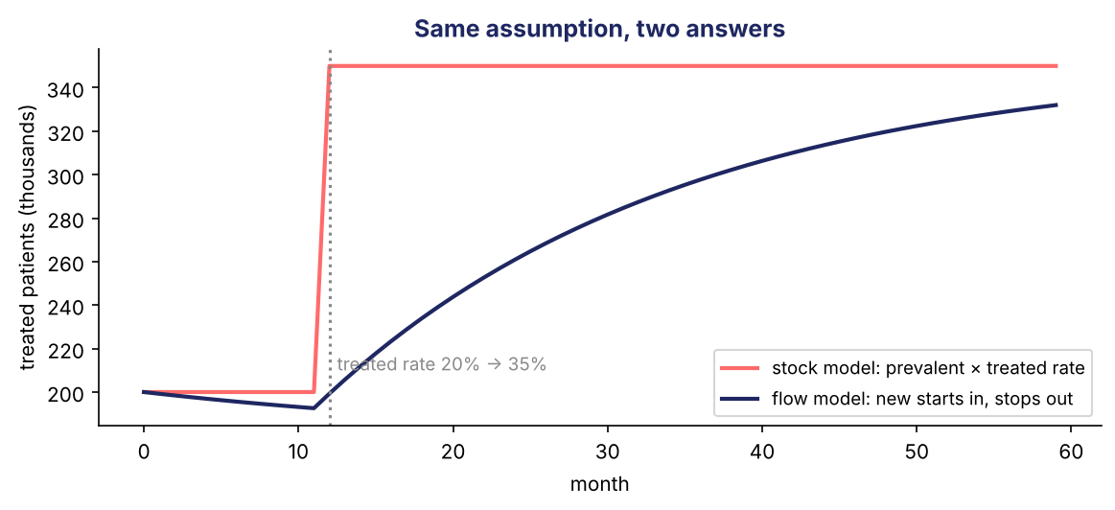
1 · FLOW vs STOCK
Flow models move patients through time; stock models take a snapshot
Flow model
Stock model
▸ Patients move from line to line, with a delay. Needed when timing matters: launches, new labels, patent expiry.
▸ Patients this year × rates × shares. Each year stands alone. Fine for stable markets.
Same assumption, two answers
▸ A treated rate rises from 20% to 35%. The stock model jumps; the flow model fills slowly through new starts.
Tonight's DLBCL funnel is a simple flow model: each line feeds the next one a year later.
Source: Briggs & Sculpher, PharmacoEconomics (1998). Chart: illustrative.
Week 6 — Forecasting in Pharma: the Patient Funnel · Pharma DS&AI · Fall 2026
9 / 40

Slide 10
1 · THREE FUNNELS
Three funnels, three different bottlenecks
DLBCL — incidence, 2027 (tonight)
New cases
22,910
Treated 1L
19,112
2L starts
5,794
3L+ starts
3,513
× brand share
111 new patients
× months × price
$8.9M
Type 2 diabetes — prevalence, 2025 (tonight)
Living with T2D
30.3M
Diagnosed
23.6M
Treated
16.9M
On add-on therapy
7.9M
On GLUCOREN
35.6k
× fills
313k Rx
Rare disease — patient finding (for contrast)
Living with it
mostly undiagnosed
Diagnosed
rises with testing
Referred
the bottleneck
Eligible
genotype, age
Treated
center capacity
× price
Oncology: progression rates. Chronic: treated rate and share. Rare: diagnosis.
Source: IQVIA, From Orphan to Opportunity (2025). Numbers: synthetic.
Week 6 — Forecasting in Pharma: the Patient Funnel · Pharma DS&AI · Fall 2026
10 / 40

Slide 11
02
The assumption book
A forecast is a list of assumptions multiplied together. Write each one down.
Week 6 — Forecasting in Pharma: the Patient Funnel · Pharma DS&AI · Fall 2026
11 / 40

Slide 12
2 · THE IDEA
A forecast is a chain of assumptions
New cases
epidemiology
× treated
treatment
× progress
treatment
× brand share
share, uptake, access
× months on therapy
persistence
× net price
price
For every assumption, write down | Example (T2)
Value: low / base / high | 26% / 31% / 36%
Source | Week 2 claims cohort, Kaplan–Meier; NEJM review
Reason | trimmed for frail patients who are not re-treated
Owner and date | forecast lead · Oct 2026
The forecast review is a review of the assumption book, not of the output.
Week 6 — Forecasting in Pharma: the Patient Funnel · Pharma DS&AI · Fall 2026
12 / 40

Slide 13
2 · LYMBREXA'S BOOK
Twenty-seven assumptions, each with a range and a source
lymbrexa_assumptions.csv · also the 'Assumptions' sheet of the Excel model
ID | Assumption | Low | Base | High | Source type
E2 | Diagnosed and presenting | 95% | 97% | 98% | Data (synthetic)
T1 | Treated in 1L | 82% | 86% | 89% | Data (synthetic)
T2 | Progress to 2L (lifetime), one year later | 26% | 31% | 36% | Data + literature
T3 | Progress to 3L (lifetime), one year later | 43% | 50% | 57% | Data + judgment
T4 | Later-lines multiplier (3L+ starts per 3L patient) | 1.14 | 1.24 | 1.34 | Data (synthetic)
B3 | Peak share of 3L+ starts | 10% | 15% | 20% | Literature + analog
B4 | Peak share of 2L starts | 6% | 10% | 14% | Judgment
U1 | Uptake: year 1 (% of peak share) | 15% | 30% | 37% | Analog
U2 | Uptake: year 2 | 60% | 90% | 95% | Analog
C1 | Coverage in launch year | 55% | 70% | 85% | Data + judgment
D1 | Average months on therapy | 5.0 | 6.0 | 7.5 | Label + data
P2 | Gross-to-net (share of WAC kept) | 72% | 76% | 80% | Judgment
L3 | Share retained after the LOE year | 25% | 40% | 55% | Literature + judgment
Source: Full book (27 rows, with sources and reasons) in the CSV and the Excel model.
Week 6 — Forecasting in Pharma: the Patient Funnel · Pharma DS&AI · Fall 2026
13 / 40

Slide 14
2 · WHERE THEY COME FROM
Five sources of an assumption — say which one you used
Data
claims, market data, analog launches
e.g. progression rates, uptake, persistence
Literature
peer-reviewed studies
e.g. order of entry; LOE erosion; cure rates
Analogs
similar past launches
e.g. how fast share builds
Plans and labels
regulatory dates, label, price
e.g. launch year, months of therapy, price
Judgment
expert view, written down
e.g. 2L peak share, gross-to-net
Judgment is allowed. Undocumented judgment is not.
Week 6 — Forecasting in Pharma: the Patient Funnel · Pharma DS&AI · Fall 2026
14 / 40

Slide 15
03
From data to assumptions
Use data to justify an assumption, not to fit a complicated model.
Week 6 — Forecasting in Pharma: the Patient Funnel · Pharma DS&AI · Fall 2026
15 / 40

Slide 16
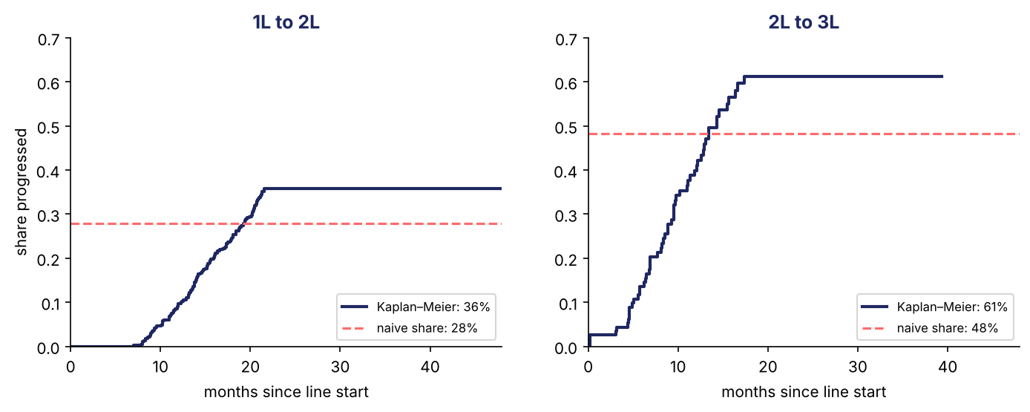
3 · PROGRESSION
Progression rates: count the patients who have not relapsed yet
Week 2 cohort · 482 DLBCL patients · Kaplan–Meier
Naive count
▸ 28% reached 2L. Too low: recent patients have not had time to relapse.
Kaplan–Meier
▸ 36% reach 2L over time. Book: 31% (T2), lag one year.
Censored means ‘not yet’, not ‘never’.
Source: Kaplan & Meier, JASA (1958); Sehn & Salles, NEJM (2021): more than 60% cured with first-line therapy. Cohort: synthetic.
Week 6 — Forecasting in Pharma: the Patient Funnel · Pharma DS&AI · Fall 2026
16 / 40

Slide 17
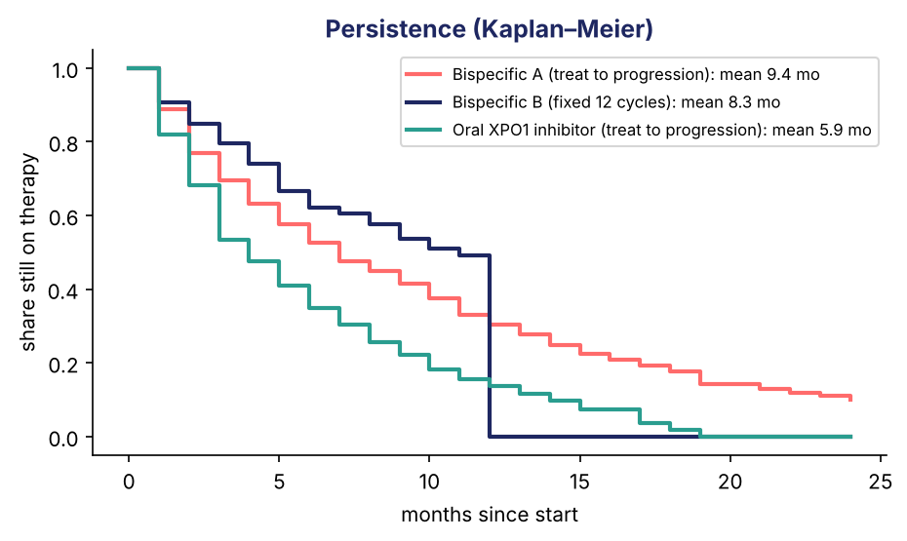
3 · PERSISTENCE
Persistence: how many months a patient stays on therapy
Persistence = time from starting to stopping
What the data say
▸ Analog regimens: 5.9 to 9.4 months on average. Naive averages are lower — they ignore patients still on.
Assumption D1
▸ 6 months: the label caps therapy at 8 cycles; some stop early. Range 5–7.5.
Patients on therapy = new patients × months on therapy ÷ 12.
Source: Cramer et al., Value in Health (2008) — definitions; Little, Operations Research (1961). Data: synthetic.
Week 6 — Forecasting in Pharma: the Patient Funnel · Pharma DS&AI · Fall 2026
17 / 40

Slide 18
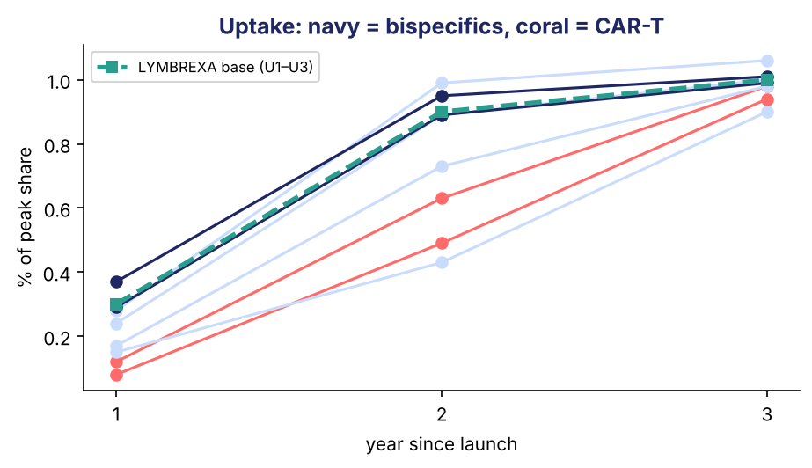
3 · UPTAKE
Uptake: read it from analog launches
Share of eventual peak reached in years 1, 2, 3
 | Year 1 | Year 2 | Year 3+
Outpatient analogs | 24–37% | 89–99% | ~100%
CAR-T (cell therapy) | 8–12% | 49–63% | ~95%
LYMBREXA base | 30% | 90% | 100%
LYMBREXA low | 15% | 60% | 95%
Why CAR-T is slower
▸ 63% of eligible patients are never referred to a treatment center.
No curve-fitting needed: a ramp table from analogs is the assumption.
Source: IQVIA, The Path to CAR T-cell Therapy (2025); Bass, Management Science (1969) for the formal S-curve. Analogs: synthetic.
Week 6 — Forecasting in Pharma: the Patient Funnel · Pharma DS&AI · Fall 2026
18 / 40

Slide 19
3 · PEAK SHARE AND ACCESS
Peak share: later entrants get less
Entrant share ≈ pioneer share ÷ √(order of entry)
0.26
0.26 ÷ √2 = 0.18
0.26 ÷ √3 = 0.15
1st (pioneer)
2nd
3rd — LYMBREXA
Peak share (B3)
Coverage (C1)
▸ Base 0.15 = the rule. High 0.20 needs evidence the others lack; low 0.10 = a weak follower.
▸ 53% of 3L+ starts come from the top 10% of prescribers. Formulary at the largest centers → 70% reachable in year 1.
Start from the rule; argue away from it only with evidence.
Source: Kalyanaram, Robinson & Urban, Marketing Science (1995) — packaged goods and prescription anti-ulcer drugs. Prescriber data: synthetic.
Week 6 — Forecasting in Pharma: the Patient Funnel · Pharma DS&AI · Fall 2026
19 / 40

Slide 20
04
The forecast
Funnel → brand → budget and long-range plan.
Week 6 — Forecasting in Pharma: the Patient Funnel · Pharma DS&AI · Fall 2026
20 / 40

Slide 21
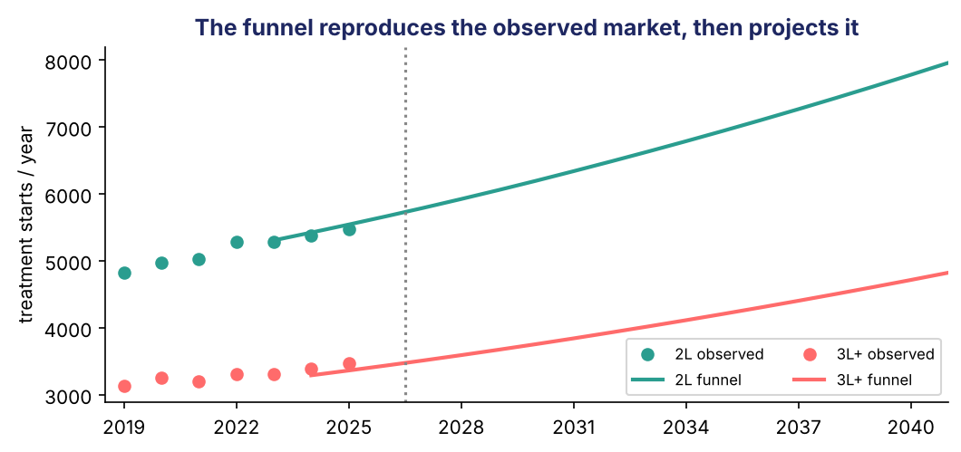
4 · THE FUNNEL
The funnel reproduces today's market, then projects it
New cases
data, +2%/yr
× diagnosed 97%
× treated 86%
= 1L
× 31% a year later
= 2L
× 50% × 1.24 a year later
= 3L+
2025 | Observed | Funnel
1L | 17,930 | 18,280
2L | 5,468 | 5,544
3L+ | 3,471 | 3,363
Within 3% of the observed market. Good enough to forecast on.
Source: dlbcl_market_monthly.csv (synthetic).
Week 6 — Forecasting in Pharma: the Patient Funnel · Pharma DS&AI · Fall 2026
21 / 40

Slide 22
4 · THE BRAND
From the funnel to LYMBREXA's patients and revenue
2032, base case
3L+ starts
3,931
× 15% × 95% coverage
560 new 3L+
+ 2L: 10% × 95%
616 new 2L
= new patients
1,176
× 6 months
588 on therapy
× $13,357 / month
$94M
New patients vs patients on therapy
Net price per month
▸ New patients is a flow; patients on therapy is a stock.
▸ On therapy = new × months ÷ 12 (Little's law).
▸ The field is paid on new patients; supply plans on patients on therapy.
▸ $18,500 list × 76% kept after rebates × 95% of doses given = $13,357.
Source: Little, Operations Research (1961). Assumptions: lymbrexa_assumptions.csv.
Week 6 — Forecasting in Pharma: the Patient Funnel · Pharma DS&AI · Fall 2026
22 / 40

Slide 23
4 · BUDGET
Budget: the first two years, by month
Month | Jan 27 | Jun 27 | Dec 27 | each month of 2028
New patients | 1.4 | 8.5 | 17.0 | 38.4
Patients on therapy (≈ new × 6) | 8.5 | 51.1 | 102.2 | 230.3
Vials | 8.1 | 48.5 | 97.1 | 218.8
Net revenue, $M | 0.1 | 0.7 | 1.4 | 3.1
2027: $8.9M. 2028: $36.9M. Launch-year phasing is a straight-line ramp — written down as assumption F1.
Week 6 — Forecasting in Pharma: the Patient Funnel · Pharma DS&AI · Fall 2026
23 / 40

Slide 24
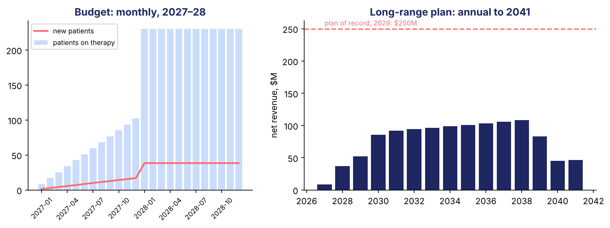
4 · LONG-RANGE PLAN
Long-range plan: $52M in 2029 and $108M at peak
Plan of record: $250M in 2029, $400M at peak
 | 2027 | 2029 | 2030 | 2032 | 2035 | 2038 | 2040
New patients | 111 | 651 | 1,065 | 1,176 | 1,259 | 1,348 | 564
Net revenue, $M | 9 | 52 | 85 | 94 | 101 | 108 | 45
Source: Model output, base case. 2L label adds patients from 2029; patent expiry in 2039.
Week 6 — Forecasting in Pharma: the Patient Funnel · Pharma DS&AI · Fall 2026
24 / 40

Slide 25
05
Ranges
Never one number. Show the range and what drives it.
Week 6 — Forecasting in Pharma: the Patient Funnel · Pharma DS&AI · Fall 2026
25 / 40

Slide 26
5 · SCENARIOS
Scenarios: every assumption low, base or high
Deliberately extreme — the outer edges, not likely outcomes
Net revenue, $M | 2027 | 2028 | 2029 | 2032 | 2035 | Peak
Low | 1 | 7 | 11 | 28 | 30 | 31
Base | 9 | 37 | 52 | 94 | 101 | 108
High | 37 | 148 | 228 | 251 | 274 | 308
Even the all-high case misses the plan's $400M peak.
Week 6 — Forecasting in Pharma: the Patient Funnel · Pharma DS&AI · Fall 2026
26 / 40

Slide 27
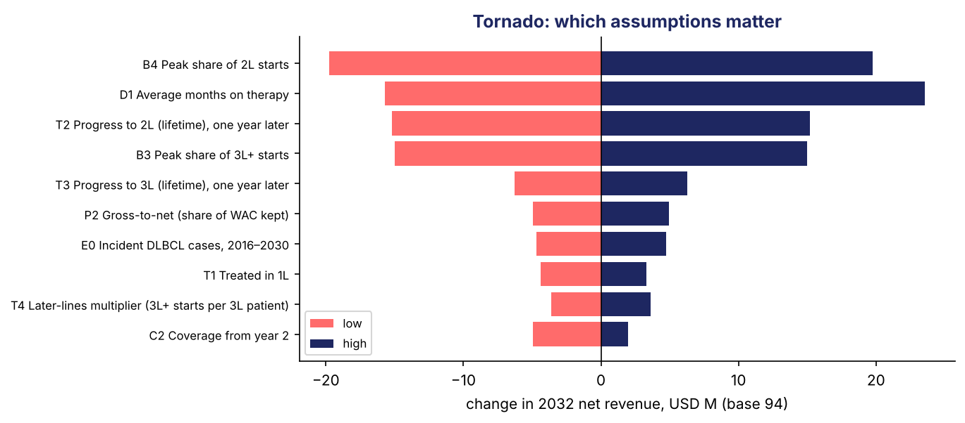
5 · TORNADO
The tornado shows which assumptions to research
One assumption at a time, low and high · 2032 net revenue, base $94M
Top four
▸ B4 Peak share of 2L starts: ±$20M
▸ D1 Average months on therapy: ±$20M
▸ T2 Progress to 2L: ±$15M
▸ B3 Peak share of 3L+ starts: ±$15M
Spend the research budget on the top bars: 2L share, months on therapy, progression rates.
Week 6 — Forecasting in Pharma: the Patient Funnel · Pharma DS&AI · Fall 2026
27 / 40

Slide 28
5 · THE CONVERSATION
What would have to be true for $250M in 2029?
To reach $250M in 2029 you need | Base case | Plausible?
3,119 new patients a year | 651 | No — 4.8× the base
…which is this share of all 3L+ starts | 15% peak | No — 85%
…or 29 months on therapy per patient | 6 months | No — label caps at 8 cycles
Honest revision: about $52M in 2029, $108M at peak. $250M needs a different drug.
Source: IQVIA, A Framework for Successful Biopharma Launches (2017): 50–70% of launches miss their first-year forecast.
Week 6 — Forecasting in Pharma: the Patient Funnel · Pharma DS&AI · Fall 2026
28 / 40

Slide 29
06
Checks
Simple cross-checks before the forecast leaves your desk.
Week 6 — Forecasting in Pharma: the Patient Funnel · Pharma DS&AI · Fall 2026
29 / 40

Slide 30
6 · MARKET TREND
Check the funnel against a simple trend of the market
3L+ starts · exponential smoothing (ETS) vs ‘same as last year’
Check | Result
Error on the last 12 months (hidden from the model) | ETS 4.6% · same-as-last-year 6.7%
3L+ starts in 2027: trend vs funnel | 3,574 vs 3,513 — gap +2%
What time series is for
Foundation models
▸ Projecting a market or an in-line brand for 1–2 years. Not a launch: there is no history.
▸ Chronos, TimesFM: pre-trained, no fitting. Useful for many series at once. Same limit: no history, no forecast.
Source: Hyndman & Athanasopoulos, FPP3 (2021) ch. 8; Ansari et al., TMLR (2024); Das et al., ICML (2024).
Week 6 — Forecasting in Pharma: the Patient Funnel · Pharma DS&AI · Fall 2026
30 / 40

Slide 31
6 · SPLIT
Split the national forecast by region and account
Top-down: last year's shares × the national forecast
2028 new patients | Academic centers | Community | Total
Northeast | 57 | 32 | 90
South | 112 | 63 | 176
Midwest | 59 | 34 | 93
West | 67 | 35 | 102
National |  |  | 461
Why top-down
▸ Simple, and every piece adds back to the national number — finance, supply and the field see one forecast.
Source: FPP3 ch. 11 for methods that reconcile forecasts made at every level. Data: synthetic.
Week 6 — Forecasting in Pharma: the Patient Funnel · Pharma DS&AI · Fall 2026
31 / 40

Slide 32
6 · LOSS OF EXCLUSIVITY
Patent expiry: borrow other drugs' history
 | Assumption | Basis
Small molecule (GLUCOREN) | brand keeps ~23% of units after one year | Grabowski et al. 2021
Biologic (LYMBREXA) | keeps 75% in the expiry year, 40% after | judgment: biosimilars erode slower
GLUCOREN Rx (thousands) | 2026 | 2027 | 2028 | 2029
Trend, no expiry | 309 | 304 | 300 | 296
With expiry (Jul 2027) | 309 | 189 | 69 | 59
Source: Grabowski, Long, Mortimer & Bilginsoy, J Med Econ (2021). GLUCOREN: synthetic.
Week 6 — Forecasting in Pharma: the Patient Funnel · Pharma DS&AI · Fall 2026
32 / 40

Slide 33
6 · PREVALENCE MODEL
GLUCOREN: a prevalence model in one line
Type 2 diabetes · 2025 · each year stands alone
Adults
266M
× 11.4% have T2D
30.3M
× 78% diagnosed
23.6M
× 72% treated
16.9M
× 47% add-on
7.9M
× 9.5% class
755k
× 4.7% brand
35.6k
× 8.8 fills
313k Rx
Calibrate
Then forecast the rates
▸ Brand share of class (4.7%) is set so the model matches 2025 prescriptions.
▸ Prevalence, treated rate and class share change slowly; write down how much per year.
Source: Rates: synthetic, stylized. CDC, Principles of Epidemiology (prevalence).
Week 6 — Forecasting in Pharma: the Patient Funnel · Pharma DS&AI · Fall 2026
33 / 40

Slide 34
07
Close
What the forecaster owns besides the number.
Week 6 — Forecasting in Pharma: the Patient Funnel · Pharma DS&AI · Fall 2026
34 / 40

Slide 35
7 · GOVERNANCE
50–70% of launches miss their first-year forecast
Assumption book
every input: range, source, reason, owner
One model
budget = first years of the LRP
Ranges
scenarios and a tornado, every time
Forecast vs actual
track your own misses
Simple checks
funnel vs market; pieces add up
Versions
what changed since last time, and why
The usual miss is too high, not random. A written assumption book is how you catch it.
Source: IQVIA, A Framework for Successful Biopharma Launches (2017), based on ~12,000 launches.
Week 6 — Forecasting in Pharma: the Patient Funnel · Pharma DS&AI · Fall 2026
35 / 40

Slide 36
7 · PITFALLS
Five common mistakes
Undocumented assumptions
nobody can challenge them
Naive counts
censored patients treated as ‘never’
New patients read as treated
persistence ignored
One number
no range, no tornado
A complicated model
nobody can follow it, so nobody trusts it
Week 6 — Forecasting in Pharma: the Patient Funnel · Pharma DS&AI · Fall 2026
36 / 40

Slide 37
7 · EXERCISE
In-class exercise — 20 minutes, groups of 3–4
Week_06_InClass_Exercise.docx
A
A · Funnel by hand
B
B · Write three assumptions
C
C · Which model
▸ 2027 inputs → 3L+ starts → new patients → patients on therapy → revenue.
▸ Peak share, uptake, months on therapy: low/base/high, source, reason.
▸ Six situations: incidence or prevalence; budget or LRP.
Short on time: Part A only.
Week 6 — Forecasting in Pharma: the Patient Funnel · Pharma DS&AI · Fall 2026
37 / 40

Slide 38
7 · HOMEWORK 2
Homework 2: a forecast for VELTRAXA
Due Monday, November 2, 11:59 PM ET · 10% of grade · data/homework2/
The brand
Deliverables
▸ Fictional oral drug for relapsed mantle cell lymphoma, launch July 2027. Same model, different disease.
▸ The Excel model (or notebook) adapted to VELTRAXA · an assumption book of 20+ rows · a two-page memo.
Assumption book | Funnel + brand | Ranges | Checks | Memo
30 | 25 | 15 | 10 | 20
Week 6 — Forecasting in Pharma: the Patient Funnel · Pharma DS&AI · Fall 2026
38 / 40

Slide 39
7 · NEXT WEEK
Week 7 — NLP in Pharma
Monday, October 26
Before Week 7
Bring
▸ Read: Reading Pack B–D; Cook, new-product chapters.
▸ Install: transformers, sentence-transformers.
▸ Start: Homework 2 — the assumption book first.
▸ Your Part B assumptions.
▸ Term project: your funnel and first ten assumptions.
Office hours Mondays 5:00–6:45 PM · ac5562@columbia.edu
Week 6 — Forecasting in Pharma: the Patient Funnel · Pharma DS&AI · Fall 2026
39 / 40

Slide 40
Questions?
1 · A forecast is a chain of assumptions. Write every one down.
2 · Pick the model shape first: incidence or prevalence.
3 · Use data to justify assumptions — handle censoring.
4 · Patients on therapy = new patients × months on therapy.
5 · One model, two horizons, always a range.
Next week — NLP in Pharma · Homework 2 due November 2
Week 6 — Forecasting in Pharma: the Patient Funnel · Pharma DS&AI · Fall 2026
40 / 40

